Slide 1
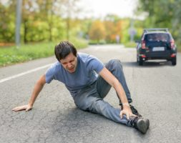
Reducing Serious Pedestrian Accidents in Chapel Hill, NC:
A Fictional North Carolina Pedestrian Crash Case Study
Geoffrey Chambers
Springboard Capstone 2

Slide 2
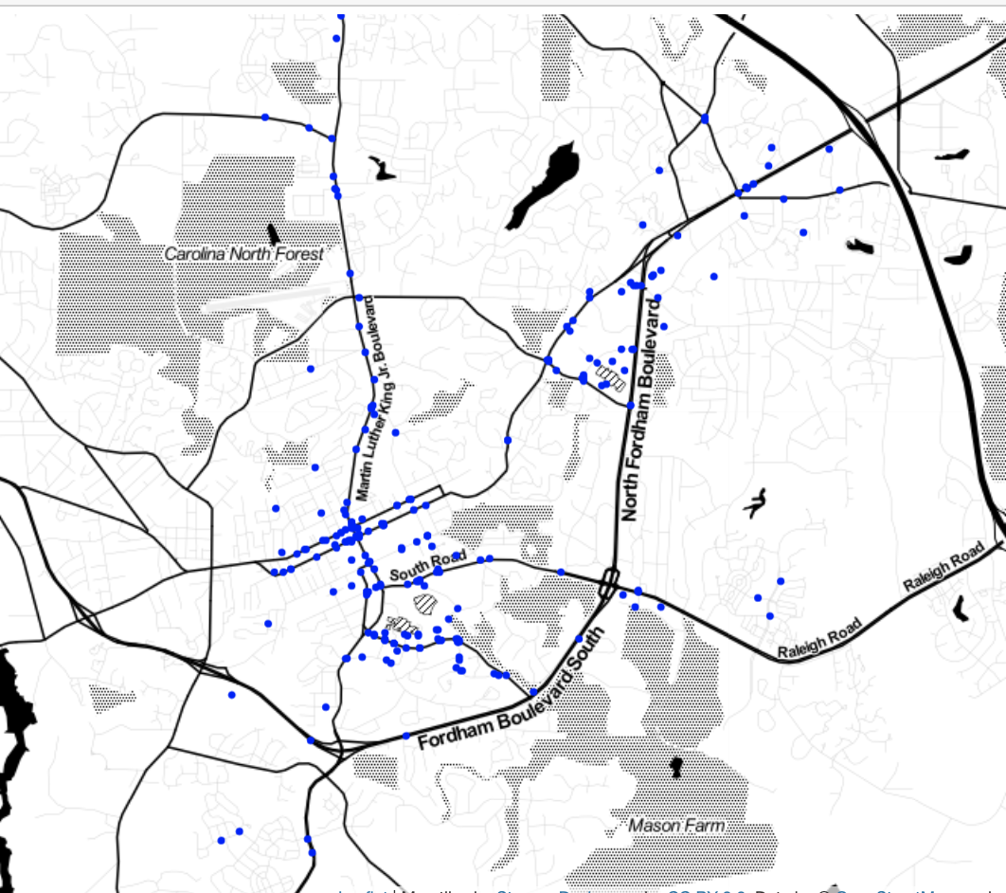
General Accident Information in NC
Every year there are about 250,000 car accidents in North Carolina.
Of those, about 3000 (1.2%) involve pedestrians.
Fortunately, a minority (13%) of those are accidents involve serious injuries or death.
Locations of Pedestrian-involved accidents in Chapel Hill, NC between 2008 and 2018

Slide 3
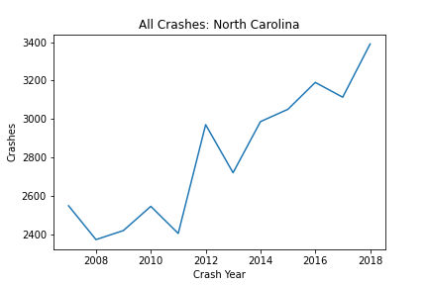
Pedestrian-Vehicle Accidents in NC
Incidents involving motor vehicles and pedestrians have been increasing over the past decade in North Carolina.

Slide 4
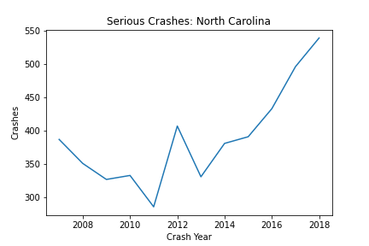
Serious Accidents in NC
Serious accidents have kept pace with the overall number of accidents.

Slide 5

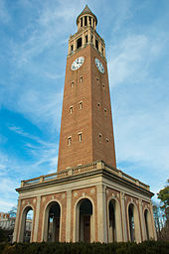
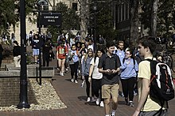
Chapel Hill, North Carolina
North Carolina’s flagship campus.
Population approximately 60,000
Normal Enrollment 30,000 total students.

Slide 6
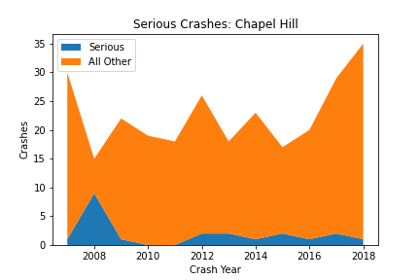
Pedestrian-Vehicle Accidents in NC
Pedestrian accidents in Chapel Hill have been relatively steady, with a steady increase in recent years.
Serious accidents in Chapel Hill have been relatively static.

Slide 7
City (Client) Objective
  Introduce preventative policies to keep the proportion of pedestrian accidents that are serious low.
Data Science Goal
  Predict the impact of various proposed policies on the proportion of pedestrian accidents in Chapel Hill that are serious.

Slide 8

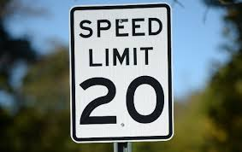
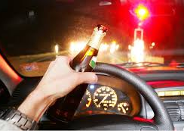

Policies to Reduce Serious Accident Rate
Place traffic controls in accident locations where none was present
Reduce the speed limits in 30-45 mph zones by 10 mph.
Introduce policies that decrease the prevalence of impaired driving.
Introduce policies that decrease young drivership

Slide 9
Method/Strategy
Obtain pedestrian-car crash data from NCDOT.
  Data contains dates, locations, demographics, etc.
Organize data for classification
  Target: determine given accident parameters, (i.e. traffic controlled, speed limit, etc.) is the accident serious?
Train classifier models
Predict the effects of changes on serious accident incidence using trained model.

Slide 10
Data Treatment
NCDOT Crash Severity Labels Reduced
  Original Labels: No injury, suspected minor injury, possible injury, suspected serious injury, and killed.
  New Label: No/Non-serious injury & serious injury
Several features, such as vehicle type, were reduced to 2-3 categories.
  Vehicle type : van, car, motorcycle, etc. -> small or large

Slide 11
Results: Gradient Boosting Classifier
Model Selected with a balance of recall score and accuracy.
Model Fitting Performance
Train | Precision | Recall | F1-Score
Non-Serious | 0.95 | 0.77 | 0.85
Serious | 0.34 | 0.74 | 0.47
Accuracy |  |  | 0.77
Model Prediction on Chapel Hill
Chapel Hill | Precision | Recall | F1-Score
Non-Serious | 0.95 | 0.92 | 0.94
Serious | 0.35 | 0.50 | 0.42
Accuracy |  |  | 0.89
Test | Precision | Recall | F1-Score
Non-Serious | 0.93 | 0.76 | 0.84
Serious | 0.33 | 0.69 | 0.44
Accuracy |  |  | 0.75

Slide 12
Proposed Policies and Prediction Implementation
Create a representative sample base of Chapel Hill
  Incidents from Chapel Hill were sampled 10,000 times with replacement
Get a baseline prediction of serious accidents
Change the samples according to policy
Predict number of serious accidents.

Slide 13
Proposed Policies and Prediction Implementation
Traffic Controls
  Converted all incidents without traffic controls to with
Reducing Speed Limits
  Incidents with speed limits of 45/40 and 35/30 were converted to 35/30 and 25/20 respectively.
Reducing Impaired Driving
  Incidents with impaired drivers were converted to not impaired
Reducing Young Drivership
  20% of the incidents with drivers ages 25 and below were removed at random.

Slide 14
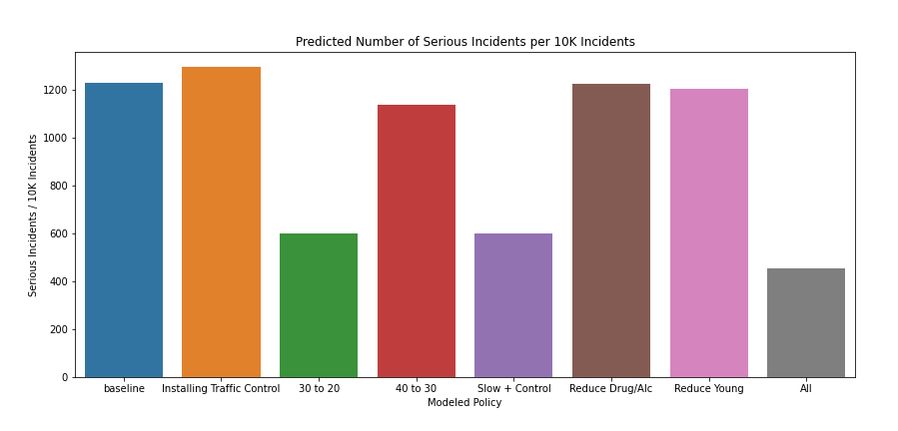
Results

Slide 15
Recommendations
Lowering the speed limits in 35/30 mph zones to 25/20 produces the greatest reduction in serious accidents.
Possible causal:
  Lower mph roads in general have more pedestrian traffic
  It is well documented that that survivorship decreases drastically when comparing a 20 mph to 30 mph collision (5% compared to 45%)

Slide 16
Limitations
Study examines overall characteristics of all accidents, not specific contingencies associated with specific intersections.
Many of the features were simplified for ease of training.
It was assumed that on a subset of demographics in NC at large are like the subset of demographics in Chapel Hill.

